Slide 1

Unreal Situations and Desires
Conditionals

Slide 2
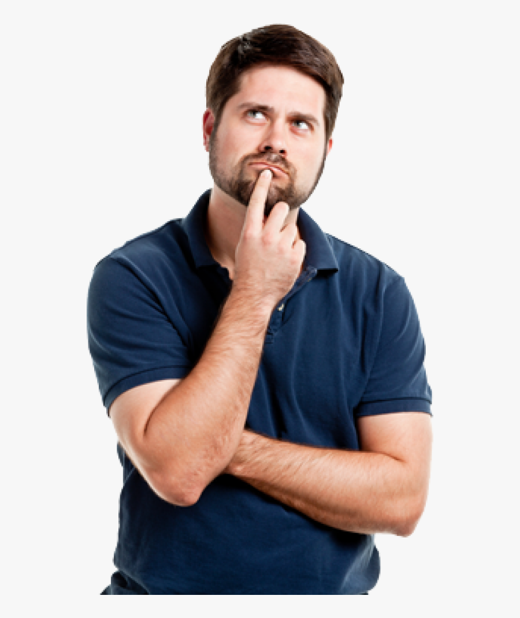
What is a conditional sentence?

Slide 3
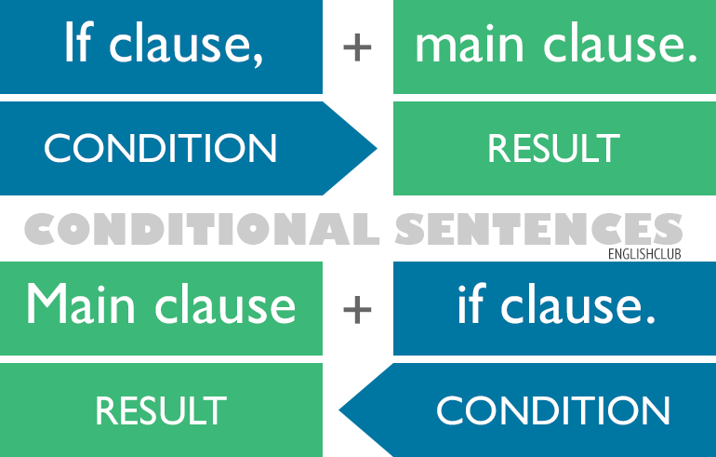
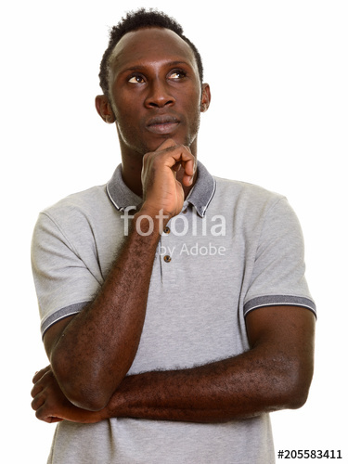
Conditionals
Conditionals describe the result of a certain condition.
Conditional tenses are used to figure out about what could happen, what might have happened and what you wish should happen
The order of the clauses does not change the meaning.

Slide 4
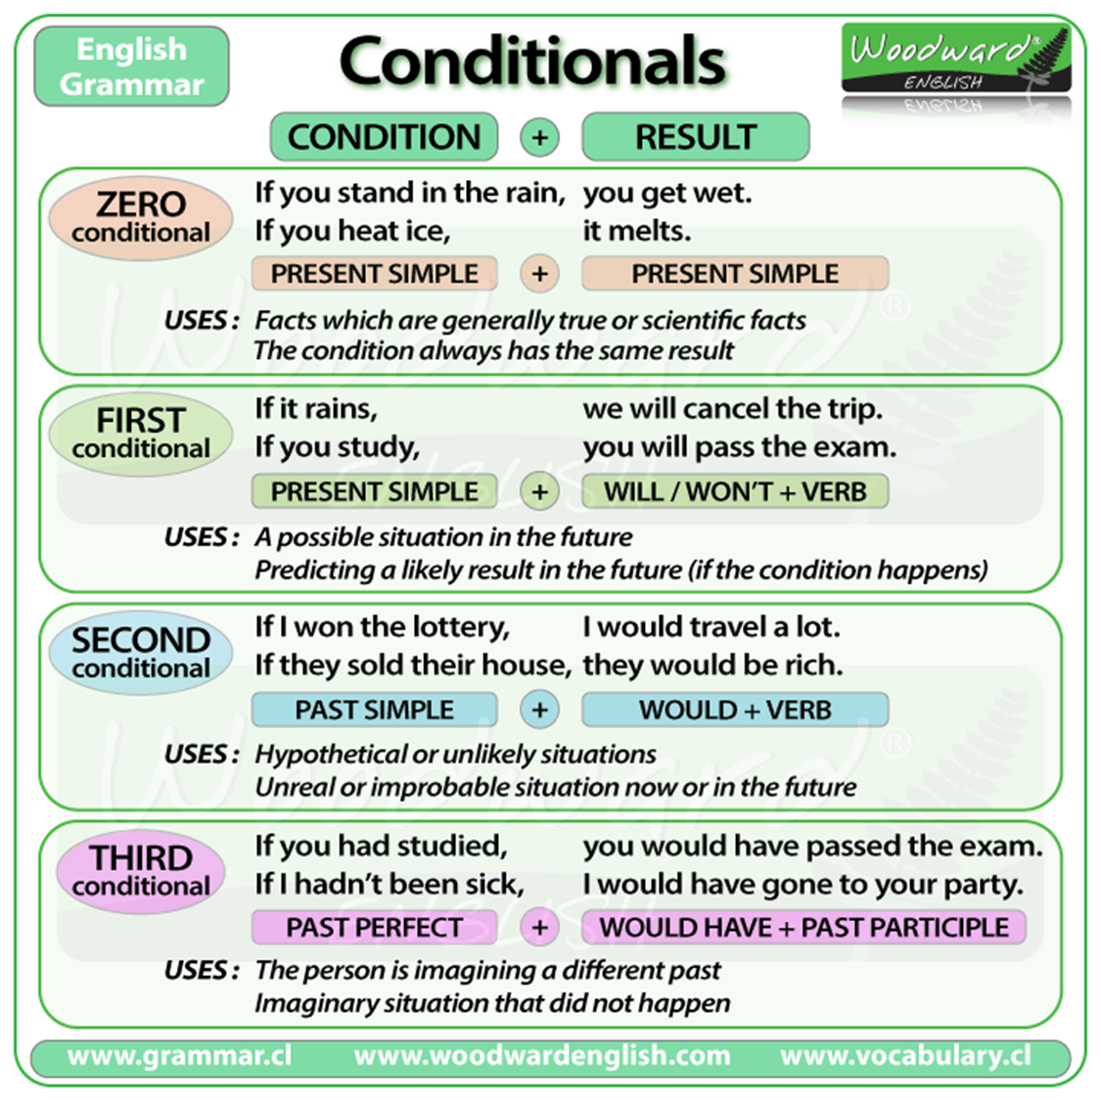

Slide 5
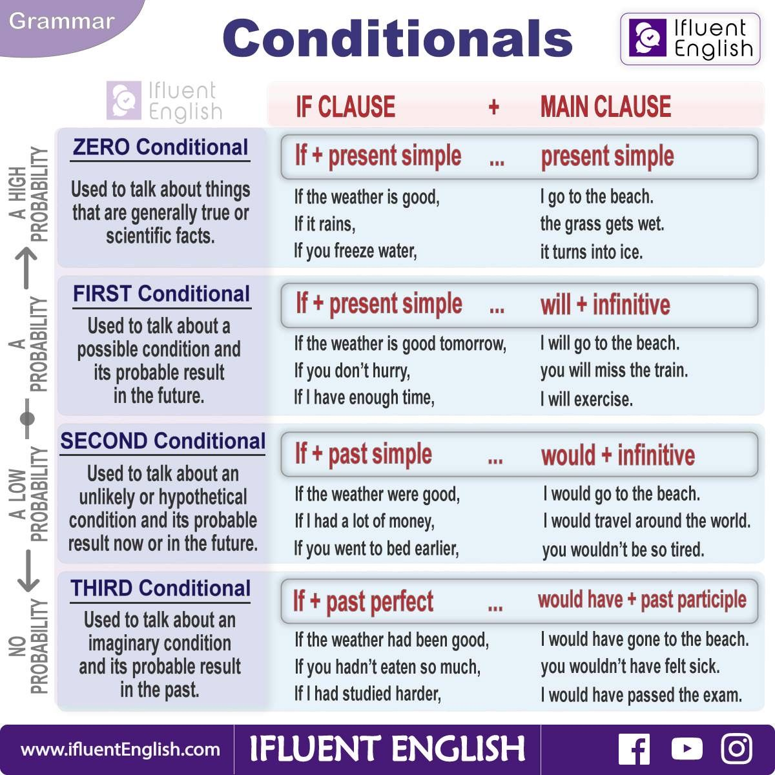

Slide 6
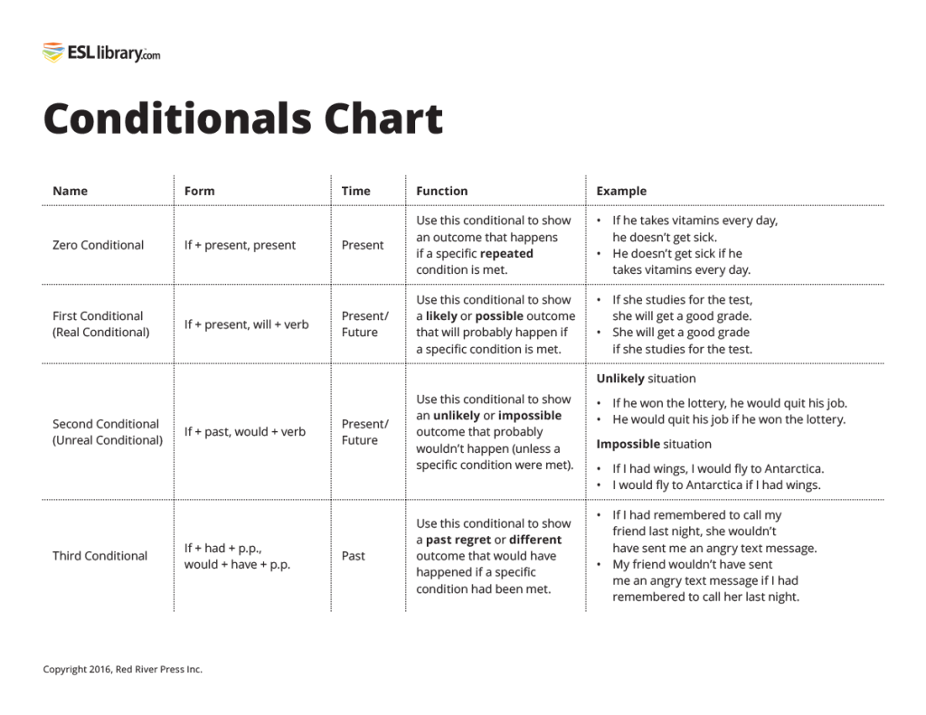

Slide 7
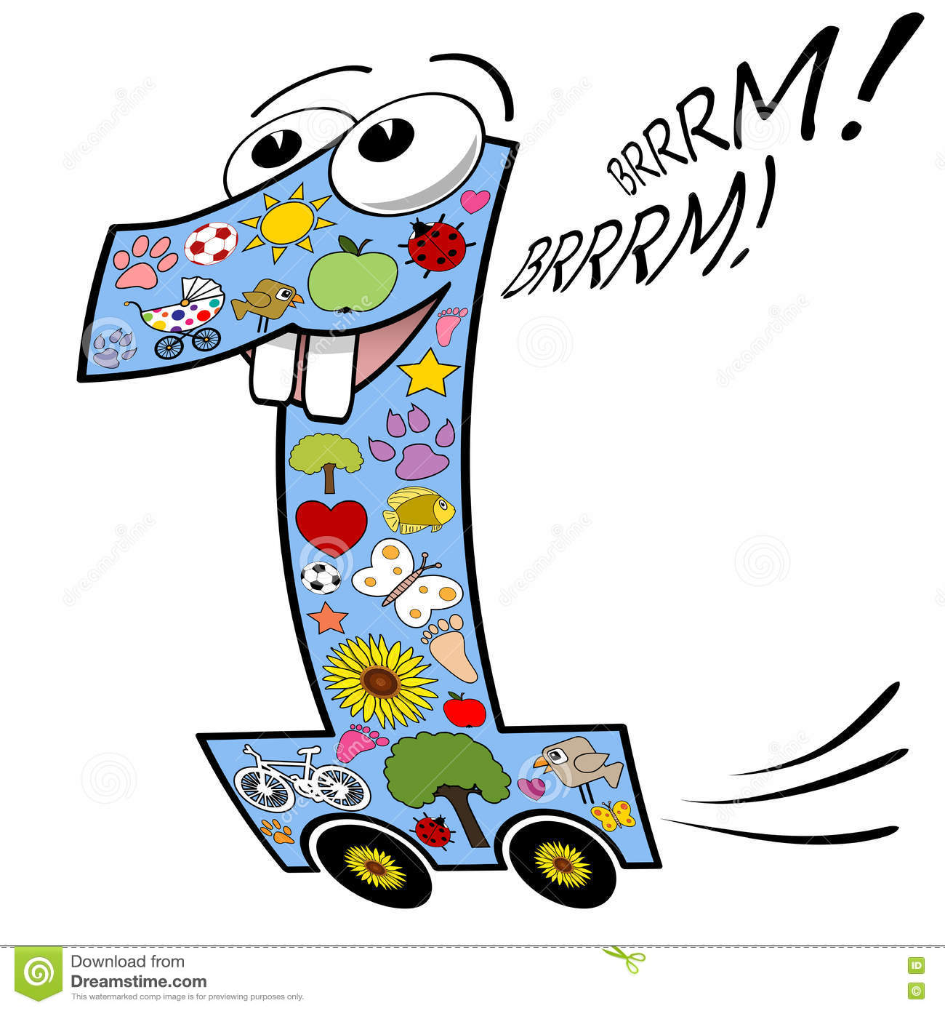
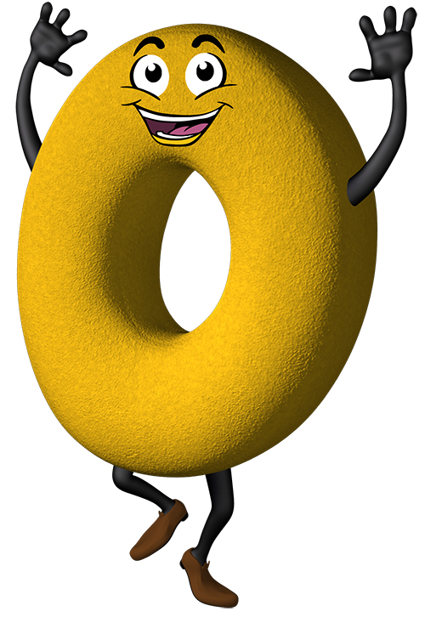

FIRST
ZERO
SECOND

Slide 8
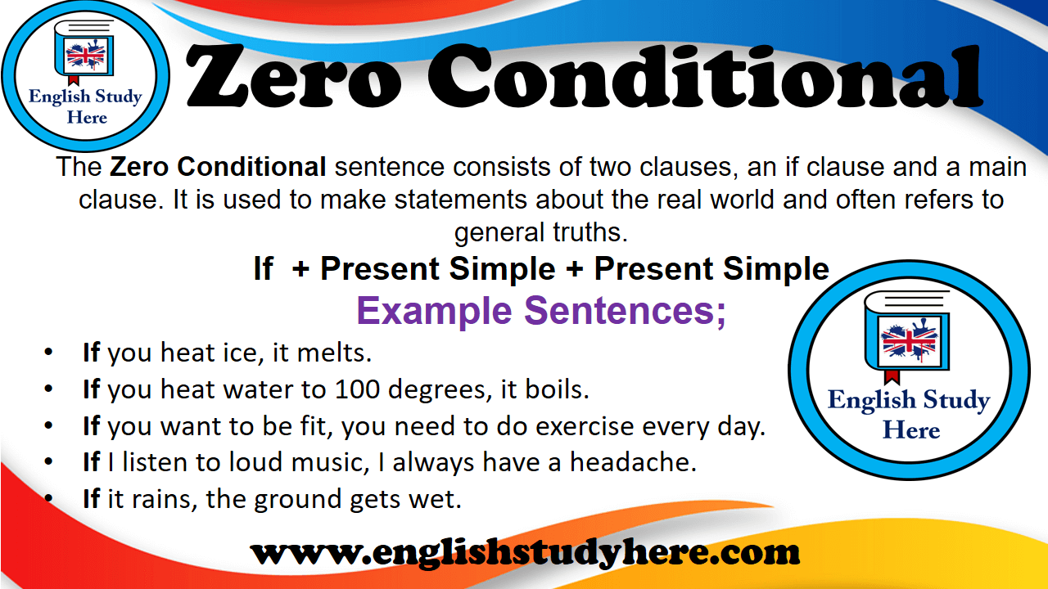

Slide 9
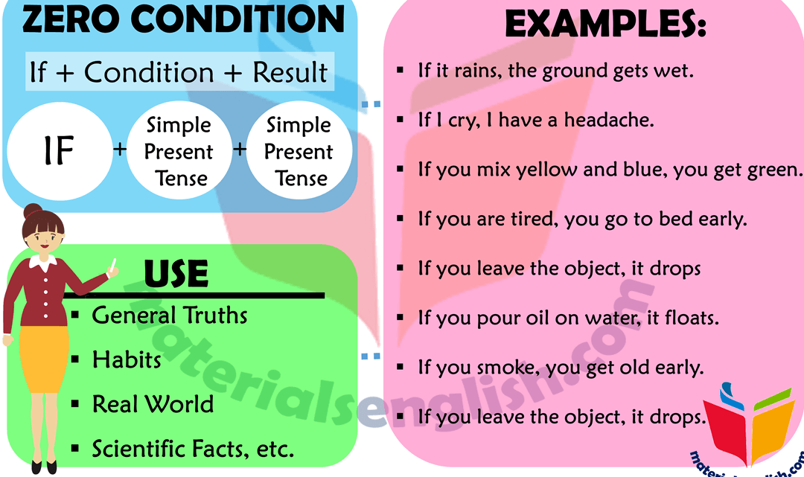

Slide 10
1. (I / wake up late / I / be late for work) _____________________________________________________________2. (my husband / cook / he / burn the food) _____________________________________________________________3. (Julie / not wear a hat / she / get sunstroke) _____________________________________________________________4. (children / not eat well / they / not be healthy) _____________________________________________________________5. (you / mix water and electricity / you / get a shock) _____________________________________________________________6. (people / eat / too many sweets / they / get fat) _____________________________________________________________7. (you / smoke / you / get yellow fingers)
____________________________________________________________
If I wake up late, I am late for work
If my husband cooks, he burns the food
If Julie doesn’t wear a hat, she gets sunstroke
If the children doesn’t eat well, they aren’t healthy
If you mix wáter and electricity, you get a shock
If people eat too many sweets, they get fat
If you smoke, you get yellow fingers.

Slide 11
8. (children / play outside / they / not get overweight)
______________________________________________________________
9. (you / heat ice / it / melt)
_____________________________________________________________
10. (I / speak to John / he / get annoyed)
____________________________________________________________
. (I / feel good the next day / I / go to bed early)
_______________________________________________________________
12. (the river / freeze / it / be very cold) _______________________________________________________________
13. (she / buy expensive clothes / she / go shopping)
_______________________________________________________________
14. (my daughter / pass her exams / she / work hard)
_______________________________________________________________
If children play outside, they don’t get overweight
If you heat ice, it melts.
If I speak to John, he gets annoyed.
If I feel good the next day, I go to bed early/
The river freezes if it is very cold.
If she goes shopping she buys expensive clothes
If my daughter works hard, she passes her exams.

Slide 12
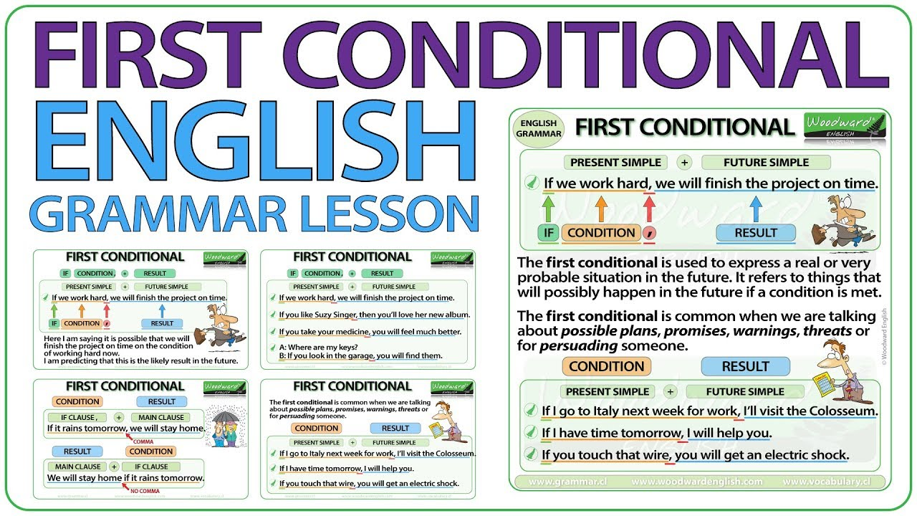

Slide 13
FIRST CONDITIONAL
If I study, I will pass my exams.
PRESENT SIMPLE
FUTURE SIMPLE
I will pass my exams if I study.
We use it to talk about possible situations and their consequences in the future.

Slide 14
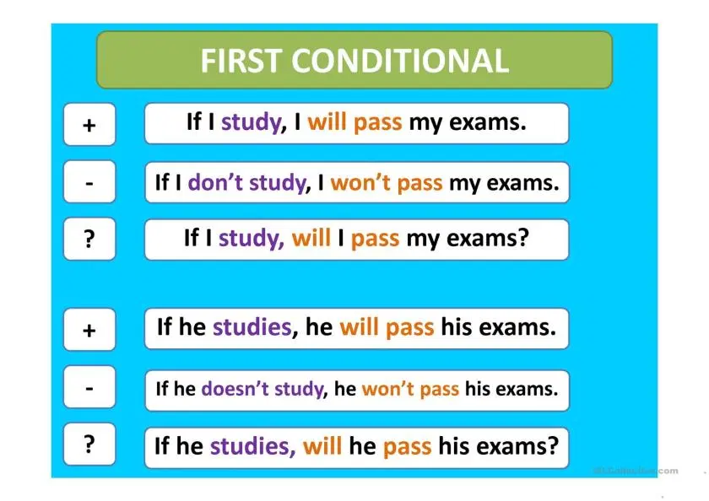

Slide 15
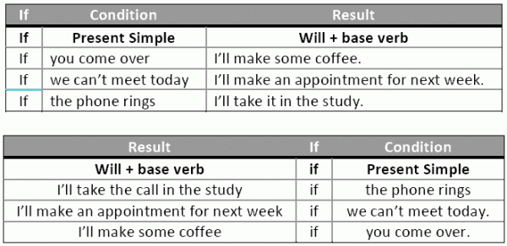

Slide 16
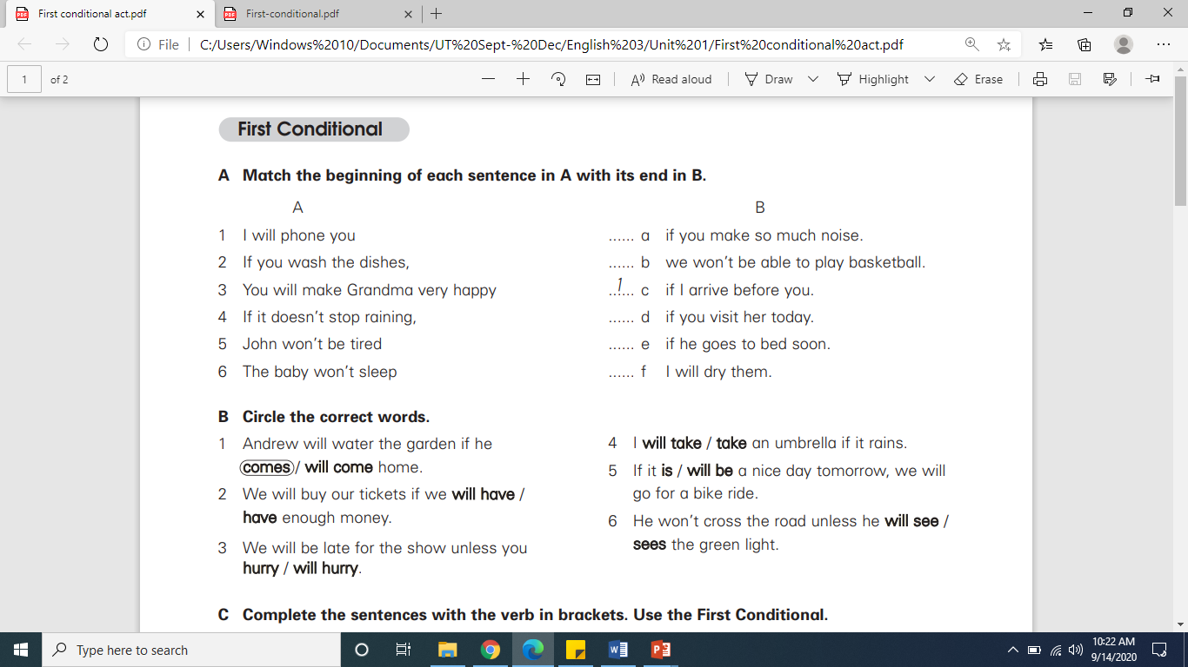
6
4
3
5
2

Slide 17
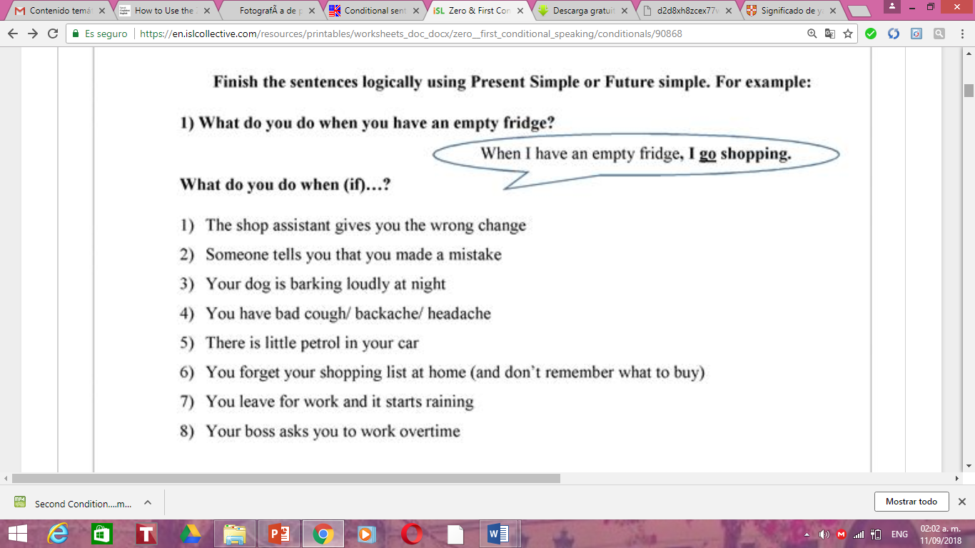
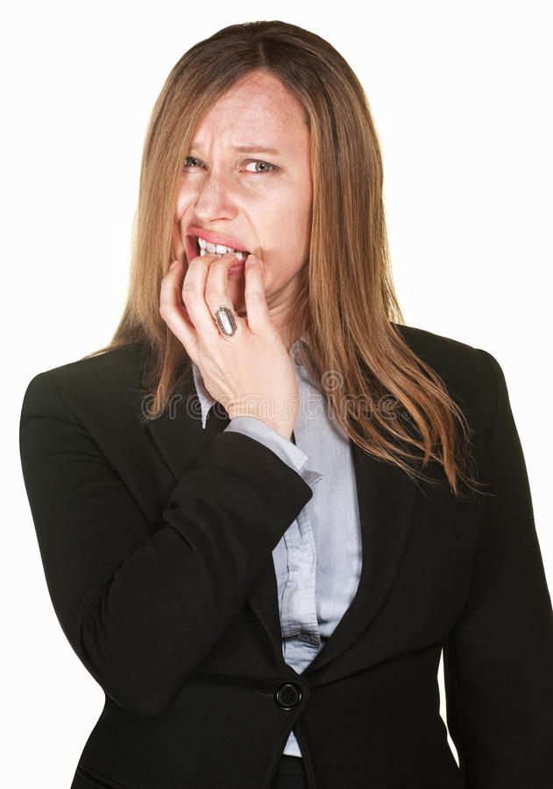

Slide 18
